Slide 1
Pre-lab Questions

Slide 2
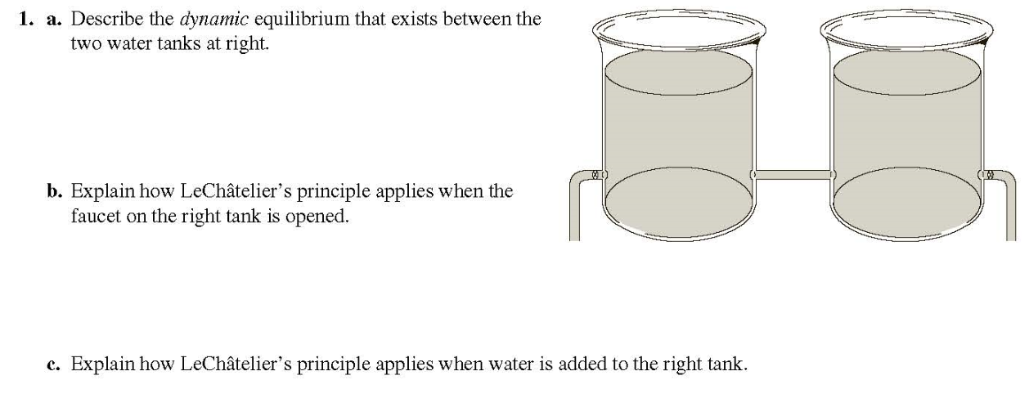
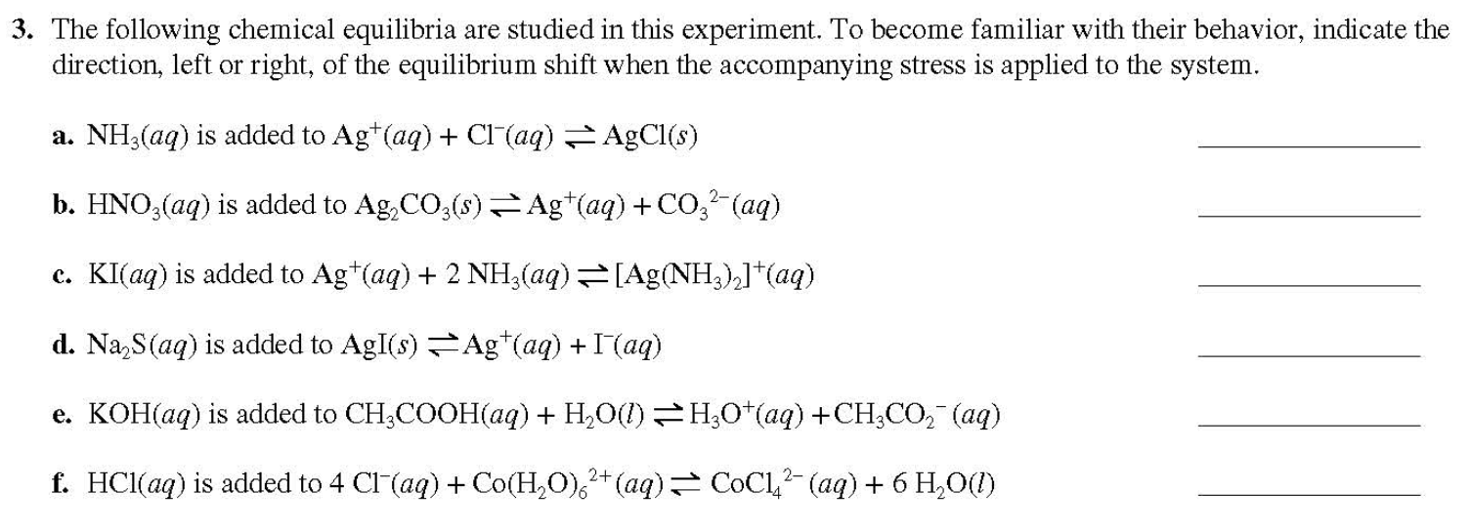
(3 points)
(6 points)

Slide 3
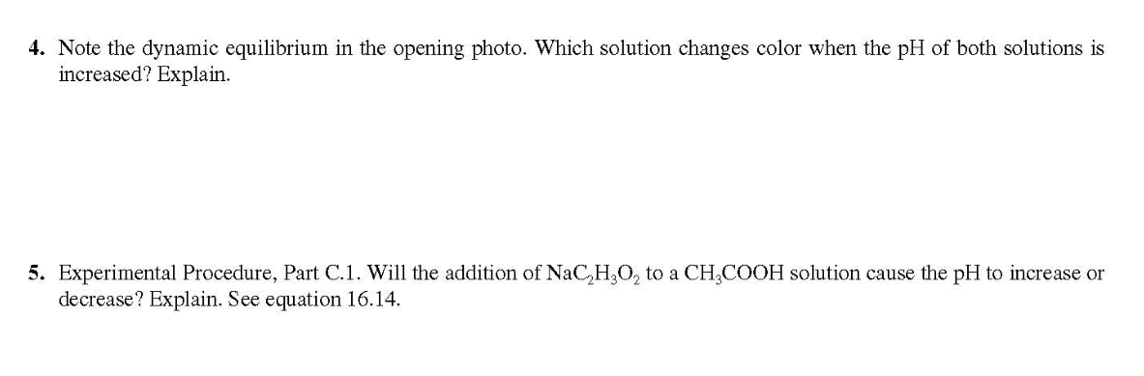
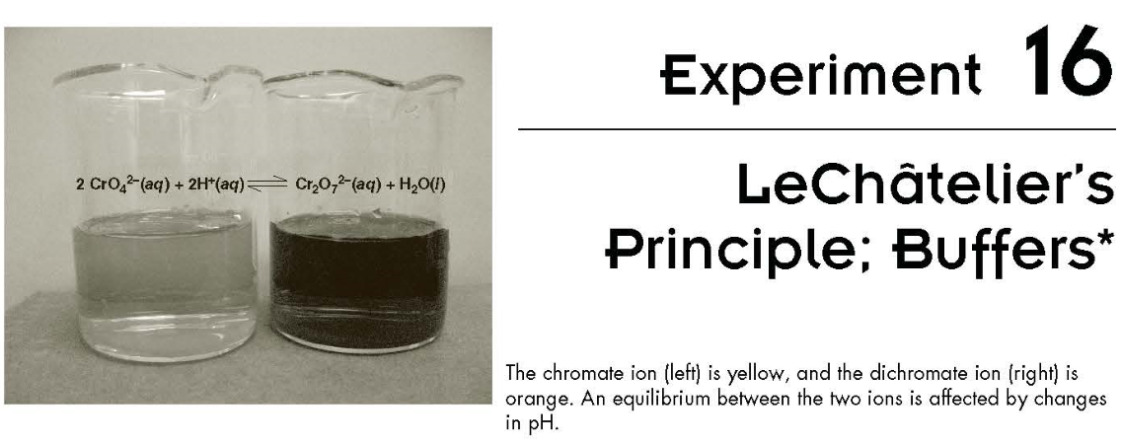
(3 points)
(3 points)
<- (#4 Opening Photo)

Slide 4
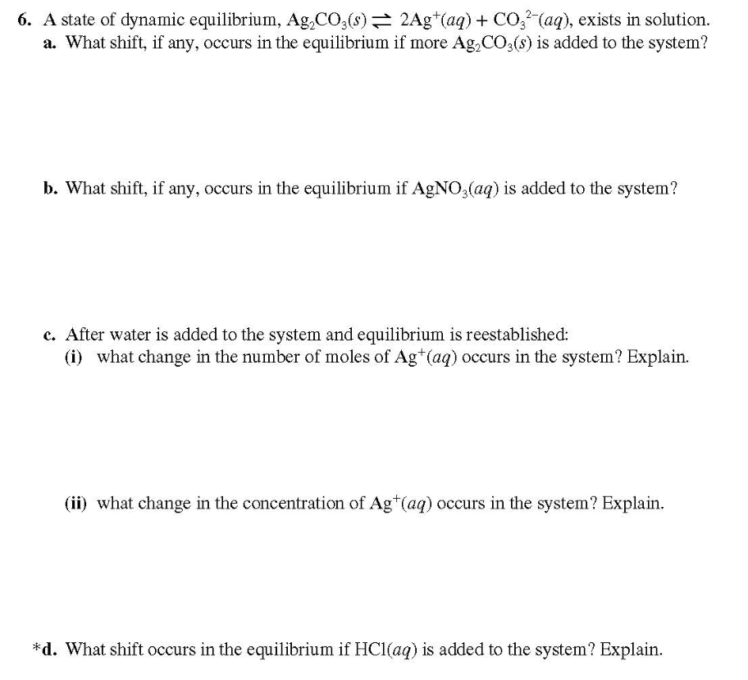
(5 points)

Slide 5
Laboratory Reports
Just answer the questions and fill the blanks shown in manual(page 26~28).
No more discussion(Summary/Assessing the results/Conclusions) is required for this report.

Slide 6
Post-lab Questions
(#2, 3, 5, 6, 7; 4 points each)

Slide 7
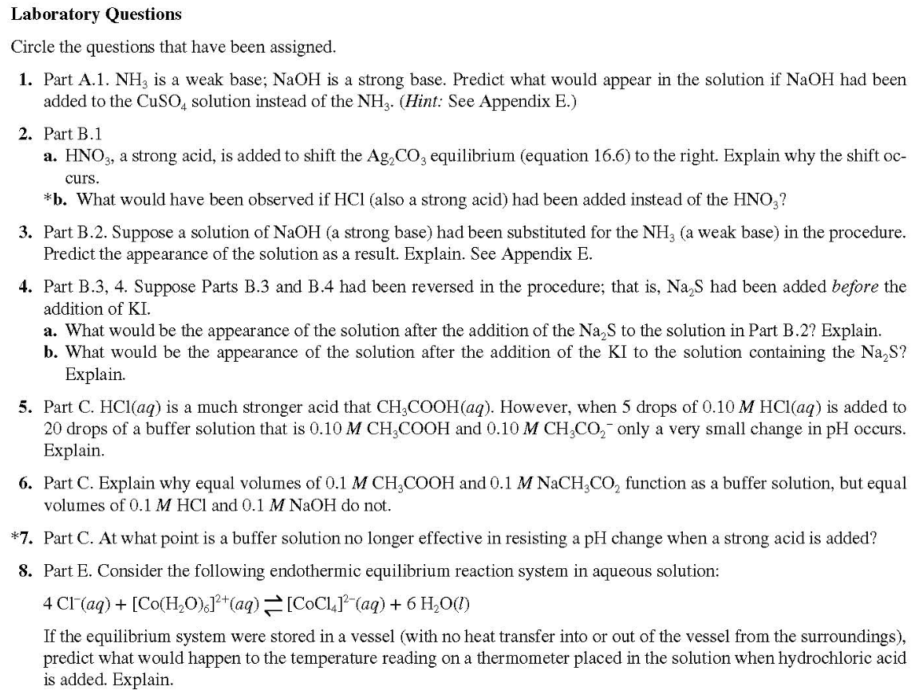

Slide 8
Textbook Content for Exp.7

Slide 9
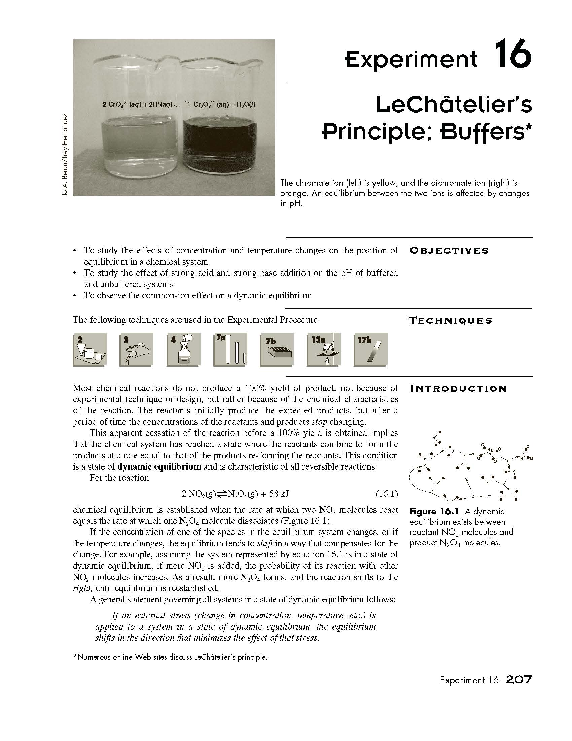
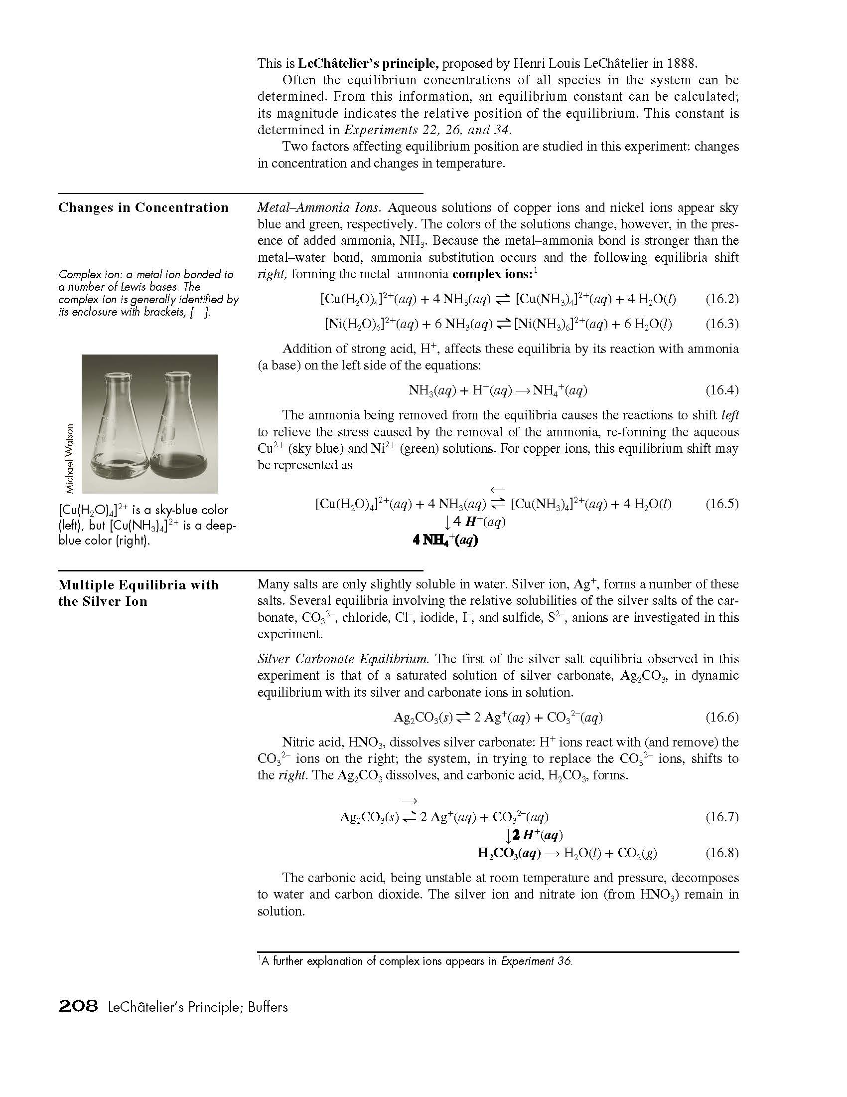

Slide 10
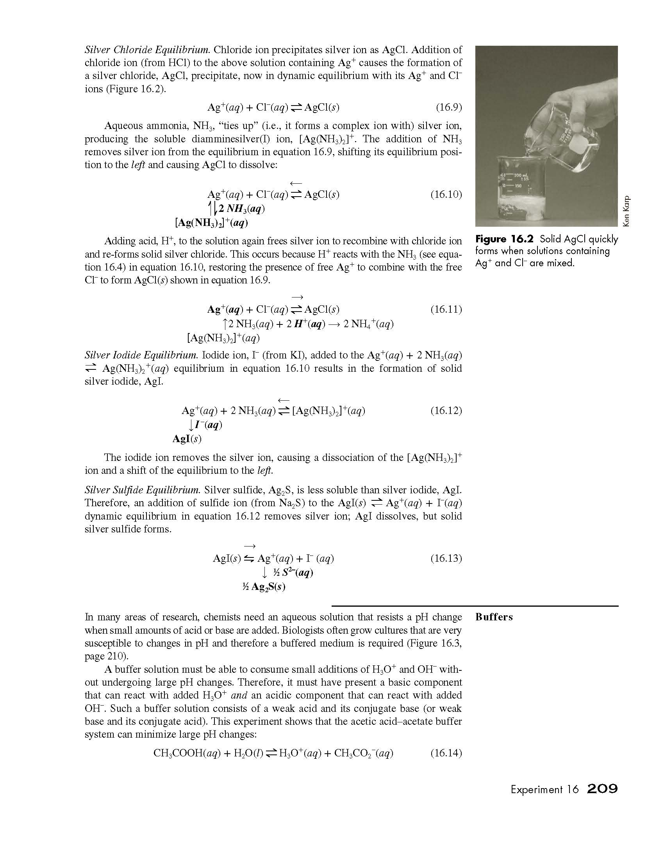
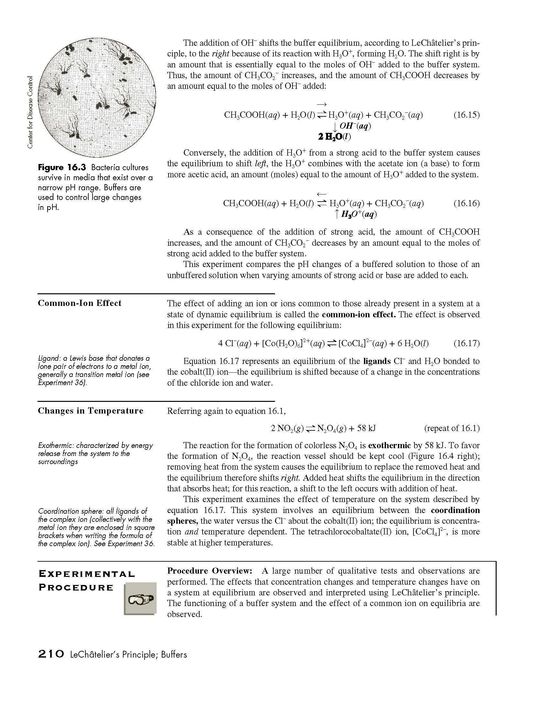

Slide 11
